Slide 1
Reactions 12
Capture of slow neutrons by hydrogen

Slide 2










































This reaction can be calculated

Slide 3





































Slide 4






















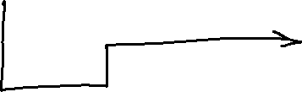




















Slide 5









Slide 6



























Slide 7












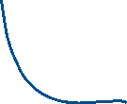


Slide 8


















Slide 9
























Slide 10































Slide 11












Slide 12

































Slide 13





























Slide 14




















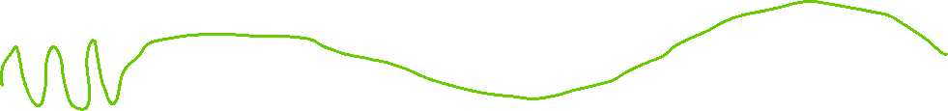


Slide 15
















Slide 16
















Slide 17





























Slide 18






















Slide 19























Slide 20






















Slide 21






















Slide 22





























Slide 23



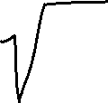



Slide 24










